Slide 1
Multi-Party Communication Ecosystem for Northeastern University
AED FINAL PROJECT - 12/10/2023
MITTUL SHARMA
ASHISH RAGHU BADHE
OMKAR VASANT NATE
SRIRAM VENKATESH

Slide 2
Problem statement
Increasing Complexity of Student Well-being: Today's students face a myriad of challenges, necessitating a comprehensive approach to their health, diet, and living arrangements.
Diverse Student Needs: Students at Northeastern University have unique dietary preferences, health concerns, and dormitory service requirements, making a tailored support system crucial.
Lack of Integrated Solutions: Currently, there's a gap in communication and collaboration between key entities such as Dormitory Services, Dieticians, Doctors, and Fitness Coaches.
Goal: To create a collaborative Multi-Party Communication Ecosystem that addresses these challenges, fostering a holistic and supportive environment for student well-being.
Emphasis on Collaboration: The objective is to move beyond individualized efforts and leverage the collective capabilities of Dormitory Services, Dieticians, Doctors, and Fitness Coaches to enhance student welfare.
The project aims to demonstrate that the collaborative efforts of these entities yield more significant benefits for student well-being than their individual contributions.

Slide 3
Solution
Our solution revolves around creating a holistic well-being ecosystem, integrating Dormitory Services, Dieticians, Doctors, and Fitness Coaches into a unified platform.
Establishing a centralized hub that facilitates seamless communication and collaboration among the various entities involved in student well-being.
Crafting use-cases that cater to specific student needs, such as dietary management, medical consultations, fitness programs, and dormitory service requests.
Ensuring a dynamic and interconnected system where Dormitory Services, Dieticians, Doctors, and Fitness Coaches can share relevant information and insights for personalized student support.
Implementing a robust authentication module to secure user access, ensuring that sensitive student data is handled with the utmost privacy and confidentiality.
Emphasizing that the collaborative effort of Dormitory Services, Dieticians, Doctors, and Fitness Coaches leads to a well-rounded and more effective support system, providing greater value to the students

Slide 4
Stakeholders - Building a Collaborative Ecosystem: Identifying Key Participants
Students: Primary beneficiaries of the system, seeking holistic support for their well-being, including dietary, medical, and fitness needs.
Dormitory Services: Manages student accommodation, handles service requests, and contributes to the overall living experience.
Dieticians: Provides nutritional guidance, dietary plans, and collaborates with other entities to ensure students' health and wellness.
Doctors: Offers medical consultations, health assessments, and contributes to the overall health and safety of the student population.
Fitness Coaches: Designs fitness programs, monitors progress, and collaborates with other stakeholders to promote a healthy lifestyle among students.
Administrators:Oversee the implementation and maintenance of the system, ensuring it aligns with the university's goals and standards.

Slide 5
USE CASES
Use Case 1: Dietary Management
Actors: Student, Dietician
Student logs in to the system and enters dietary preferences, allergies, and health goals.
Dietician accesses the information to create personalized dietary plans.
System notifies the student of suggested meals, considering their preferences and nutritional needs.
Dietician and Student can communicate within the system for adjustments and updates to the dietary plan.

Slide 6
USE CASES
Use Case 2: Medical Consultation and Appointment Scheduling
Actors: Student, Doctor
Student schedules a medical consultation through the system based on their availability.
Doctor accesses the appointment details and reviews the student's medical history.
During the consultation, Doctor updates the system with diagnosis, prescriptions, and recommendations.
System sends notifications to the student for follow-up appointments or medication reminders.

Slide 7
USE CASES
Use Case 3: Fitness Program Enrollment
Actors: Student, Fitness Coach
Student expresses interest in fitness programs available within the system.
Fitness Coach reviews student profiles to recommend suitable programs.
Student enrolls in a fitness program through the system.
System tracks progress and updates both the Fitness Coach and Student on achievements and milestones.

Slide 8
USE CASES
Use Case 4: Dormitory Service Requests
Actors: Student, Dormitory Services
Student submits a service request through the system for maintenance or other dormitory-related issues.
Dormitory Services reviews and prioritizes requests based on urgency and availability of resources.
System updates the student on the status of their request and completion timelines.
Dormitory Services and Student can communicate within the system for additional details or updates.

Slide 9
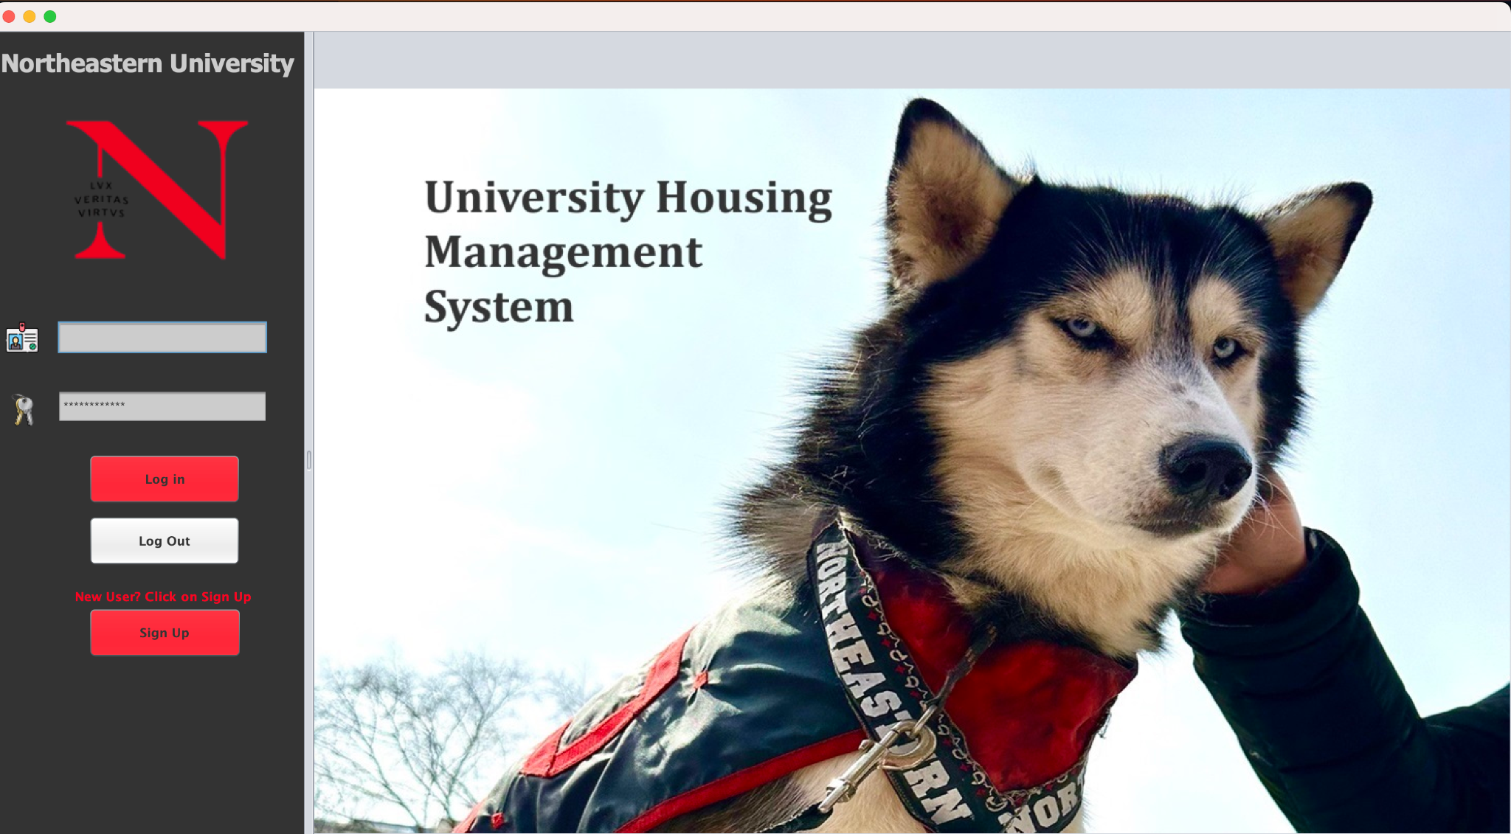
DESIGN AND UI LAYOUT

Slide 10
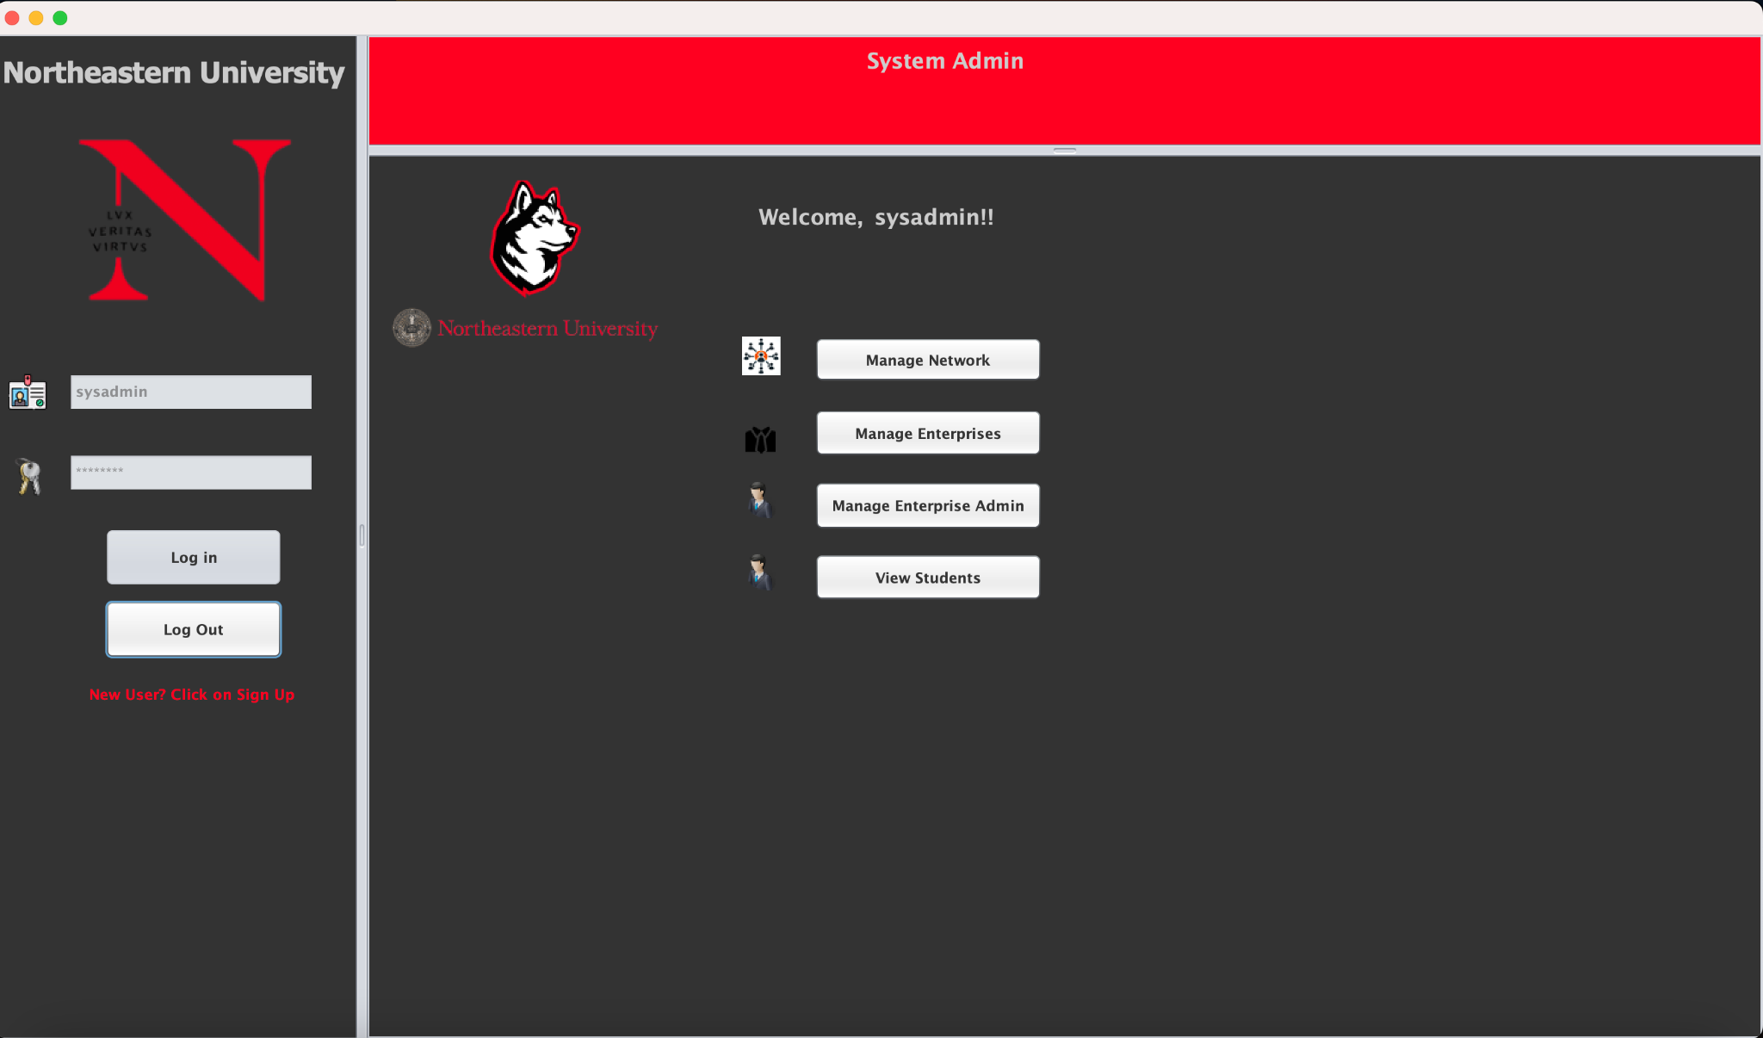
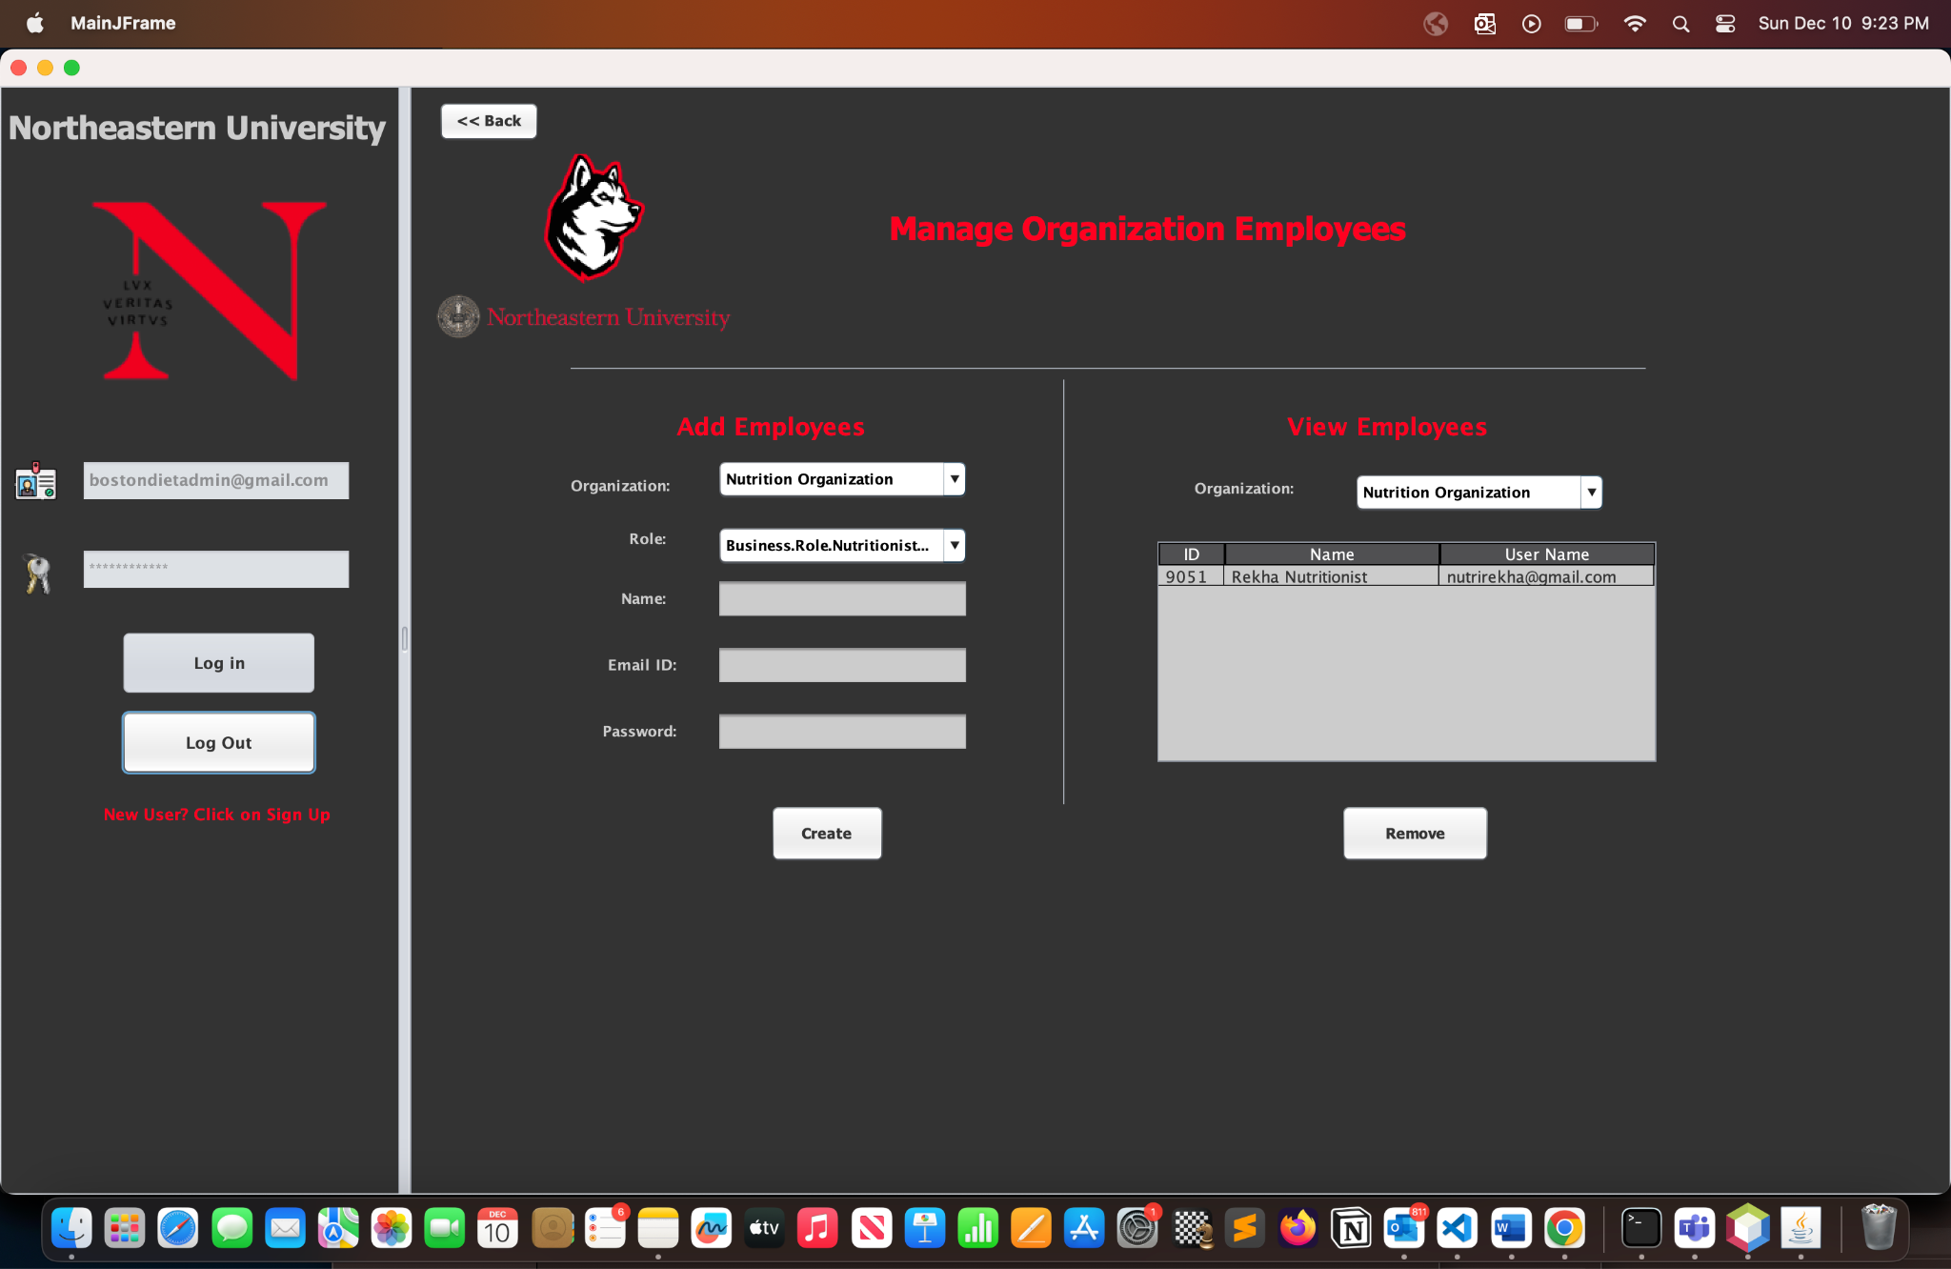
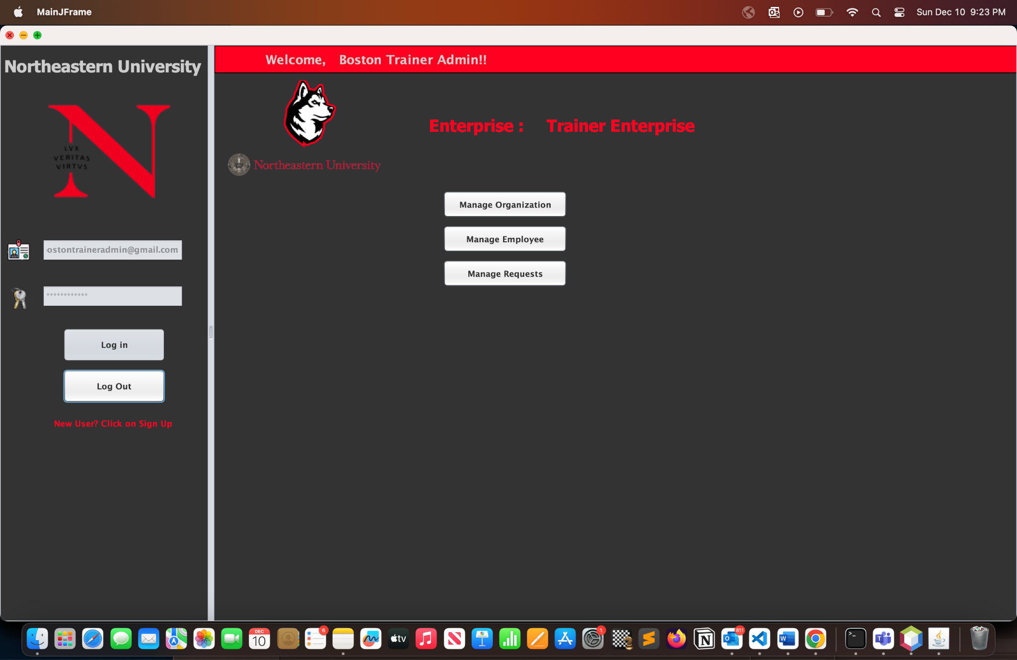

Slide 11
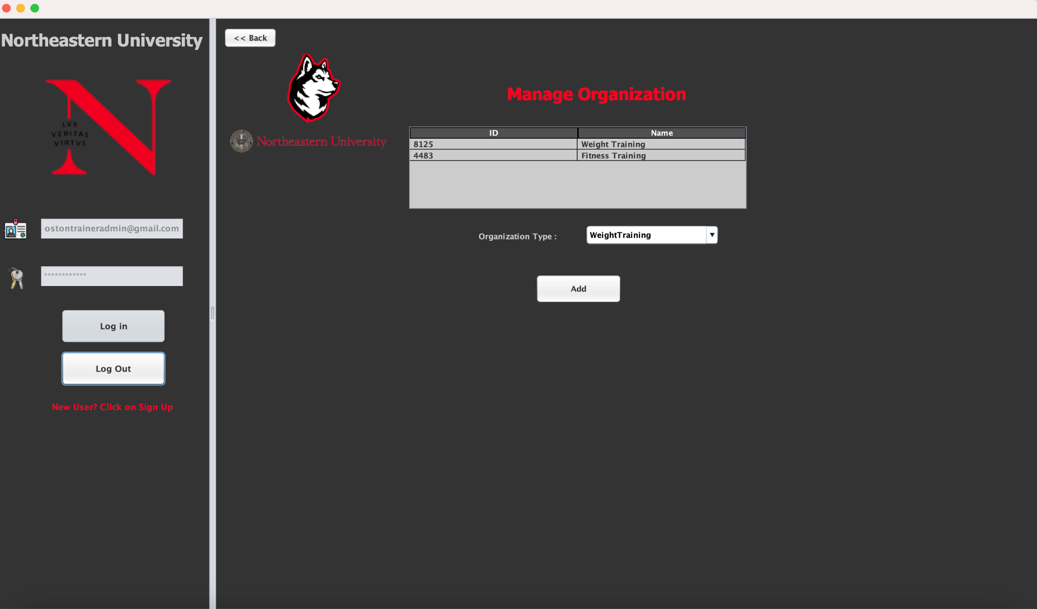
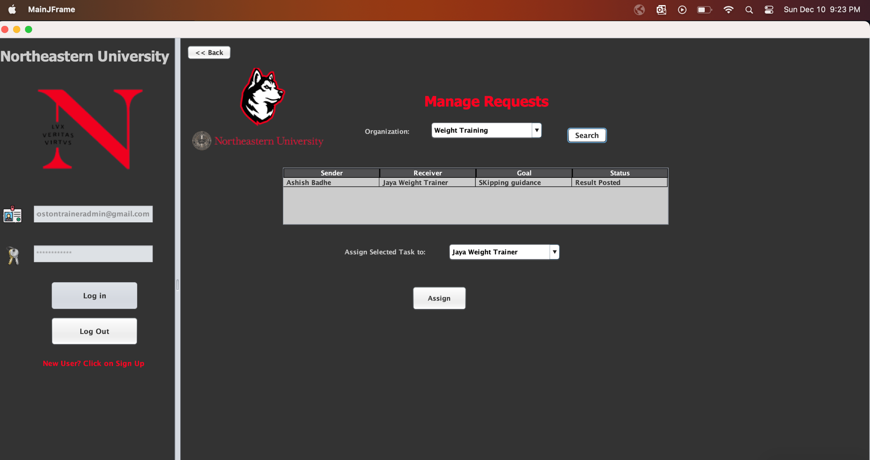
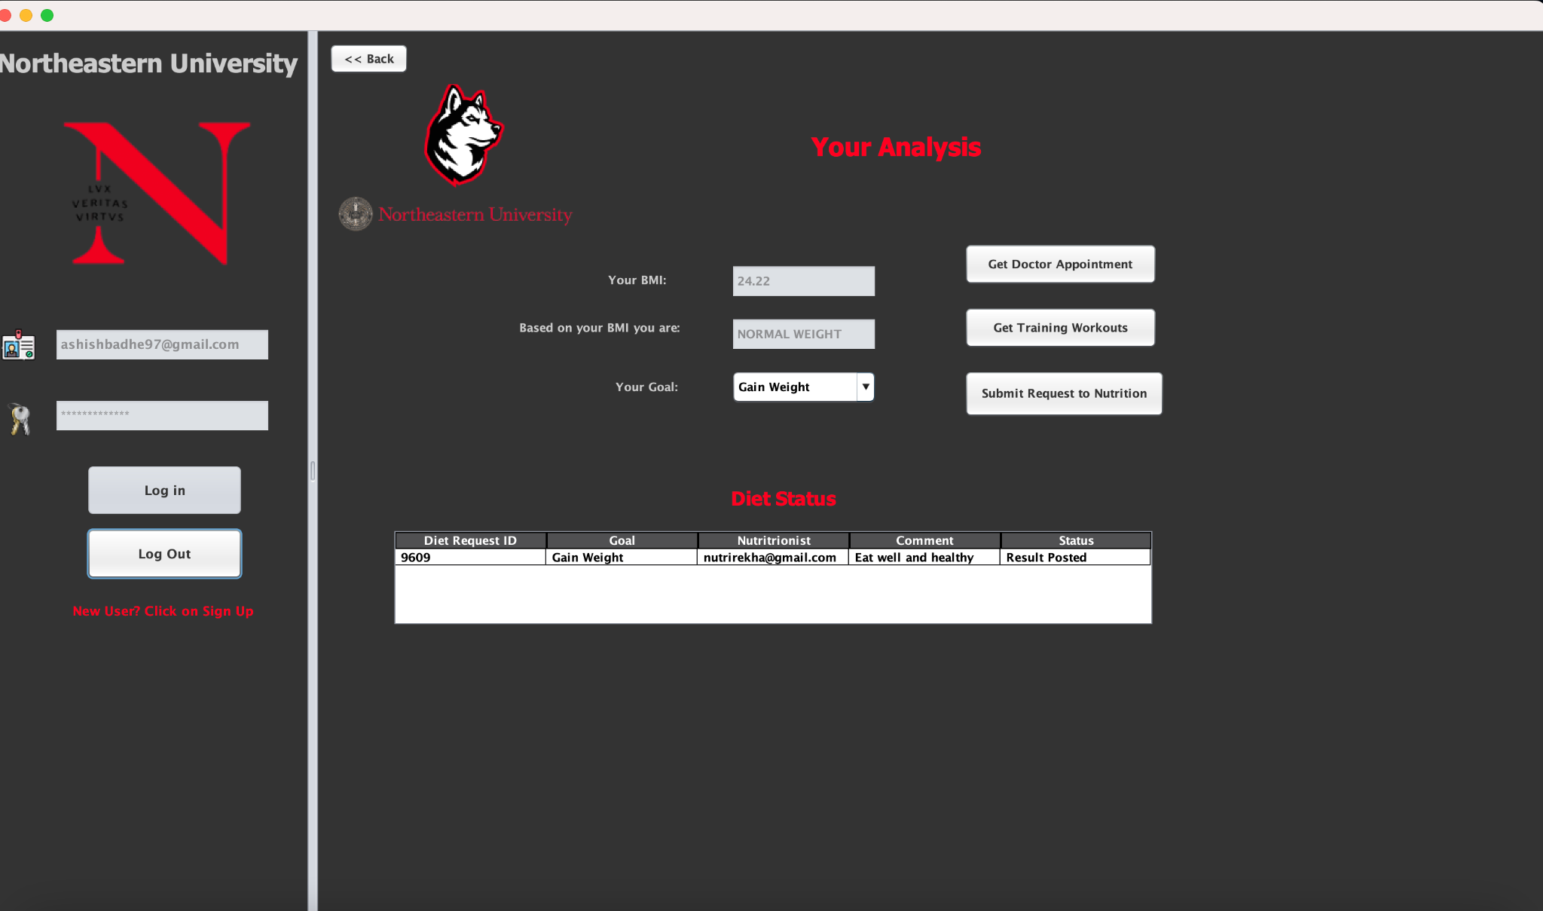
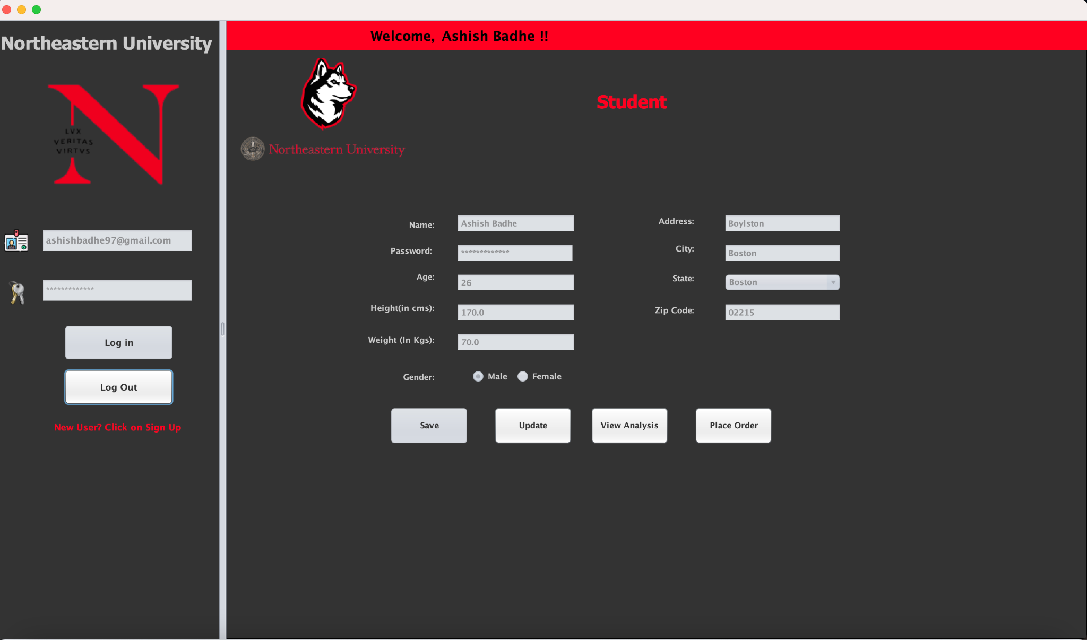

Slide 12
IMPLEMENTATION TECHNIQUE
1. Architecture:
We've adopted the Model-View architecture to ensure a modular and maintainable codebase.
Clear separation of concerns facilitates easier development, testing, and future modifications.
2. Swing Components:
Leveraging Java Swing components (JFrame, JPanel, etc.) to design an intuitive and user-friendly interface.
Provides a familiar and responsive GUI for efficient user interactions across different modules.
3. Database Integration (DB4O):
Integrating DB4O for database operations, implementing CRUD operations for entities like students, appointments, and service requests.
Efficient storage and retrieval of data, ensuring the persistence and integrity of our system's information.
4. Authentication Module:
Implementing a role-based authentication system with secure password handling for user access.
Ensures data security and restricts access based on predefined roles (Student, Dietician, Doctor, Fitness Coach, Dormitory Services).

Slide 13
IMPLEMENTATION TECHNIQUE
5. Exception Handling:
Implementing robust exception handling mechanisms to gracefully manage errors and provide meaningful error messages.
Enhances the application's reliability, making it more resilient to unexpected issues.
6. Version Control and Code Review:
Utilizing version control (e.g., Git) for managing changes and conducting regular code reviews.
Ensures code quality, facilitates collaboration, and establishes a systematic approach to development and maintenance.
7. Documentation:
Maintaining clear and comprehensive documentation for the codebase, including Javadoc comments for methods and classes.
Enhances code readability, aids future development, and facilitates collaboration within the team.

